Slide 1
Documentation
Introduction This project is a Hotel Management System that allows guests to book rooms, modify or cancel reservations, and make payments. It also enables the admin to manage rooms and monitor bookings. | Objectives • Make room booking easier for guests. • Organize and manage room and booking data. • Provide a simple and secure payment process. • Help the admin manage the hotel more efficiently.
Functional Requirements • User can register/login • View available rooms and room details. • Create a booking. • Edit or cancel a booking. • Payment (Cash / Credit Card). • Admin: Add / Update / Remove rooms. • Admin: View and monitor all bookings. • System generates receipts | Non-Functional Requirements • Usability: Easy and simple user interface. • Performance: Fast response when loading rooms and bookings. • Security: Protect user accounts and booking data. • Reliability: System works consistently with minimal errors.

Slide 2
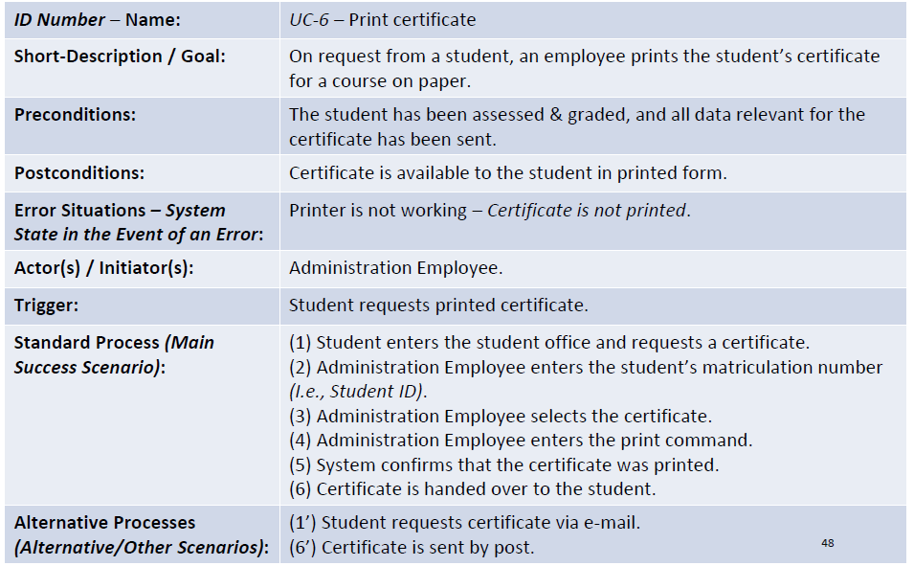

Slide 3
Use case name: | Login
Scenario: | Guest enters email & password to access the hotel system.
Triggering event: | User wants to log into their account.
Brief description: | User provides login credentials; the system checks validity and grants access or returns an error.
Actors: | Guest
Related use cases: | • Sign Up (if user has no account)
Stakeholders: | Guest, Hotel Management
Preconditions: | • User must already have an account • System must be online
Postconditions: | • User is logged in • Session is created
Flow of activities: | Actor | System
 | Enters email & password 2. Clicks login | 1.1 Validates credentials 1.2 Opens user dashboard
Exception conditions: | • Invalid email or password • Account not found

Slide 4
Use case name: | Sign Up
Scenario: | User creates a new account.
Triggering event: | Guest wants to sign up.
Brief description: | Guest enters full name, email, password; system stores user data.
Actors: | Guest
Related use cases: | Login
Stakeholders: | • Guest • Hotel System Administrators (database stored safely)
Preconditions: | • Email is not already registered
Postconditions: | • New account created • User can now log in
Flow of activities: | Actor | System
 | 1. Enters required personal info 2. Clicks Register | Validates info Creates new account
Exception conditions: | • Email already exists • Invalid input

Slide 5
Use case name: | View Room Details
Scenario: | User views room information before booking.
Triggering event: | User clicks on a room or "View Details".
Brief description: | System displays images, price, available dates, and features.
Actors: | Guest
Related use cases: | Book Room
Stakeholders: | • Guest • Hotel Management • Receptionist (may verify booking later)
Preconditions: | • Rooms must exist in the database
Postconditions: | • Room information displayed successfully
Flow of activities: | Actor | System
 | Selects a room | Displays full room details
Exception conditions: | • Room not found • Server error

Slide 6
Use case name: | Book Room
Scenario: | Guest reserves a room.
Triggering event: | User clicks "Book Now".
Brief description: | Guest enters booking dates, number of guests; system checks availability then reserves the room.
Actors: | Guest
Related use cases: | • View Room Details • Make Payment • View Receipt
Stakeholders: | • Guest • Hotel Management • Receptionist (may verify booking later)
Preconditions: | • User must be logged in • Room must be available
Postconditions: | • Booking created • User proceeds to payment
Flow of activities: | Actor | System
 | Selects check-in & check-out Confirms booking | Checks availability Creates booking record
Exception conditions: | • Room unavailable • Invalid dates

Slide 7
Use case name: | Make Payment
Scenario: | Guest pays to confirm booking.
Triggering event: | User selects payment method.
Brief description: | User pays using cash or credit card; system confirms payment.
Actors: | Guest, Receptionist (external actor)
Related use cases: | View Receipt
Stakeholders: | • Guest • Hotel Management • Bank System (external payment processor)
Preconditions: | • Booking exists and requires payment
Postconditions: | • Payment completed • Booking becomes confirmed
Flow of activities: | Actor | System
 | Selects cash/credit Enters credit info (if credit) | Verifies amount Sends request to bank Marks booking as paid
Exception conditions: | • Card declined • Payment timeout

